Slide 1
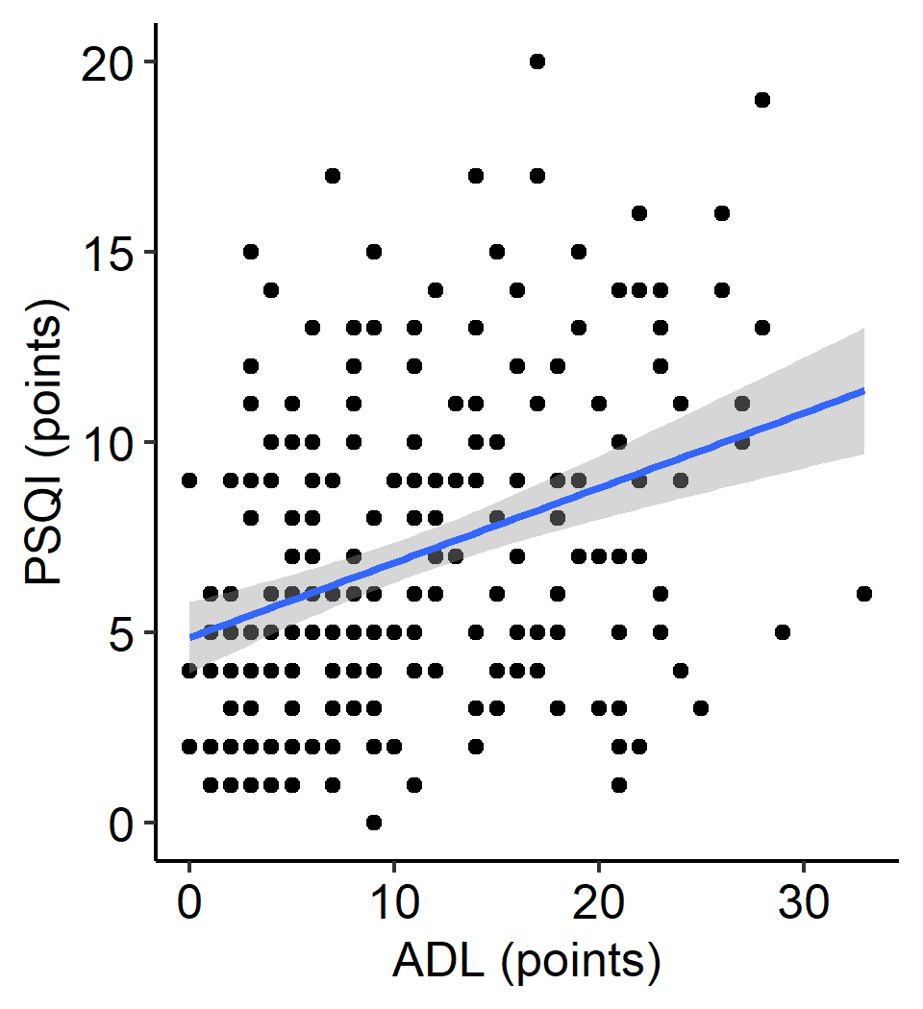
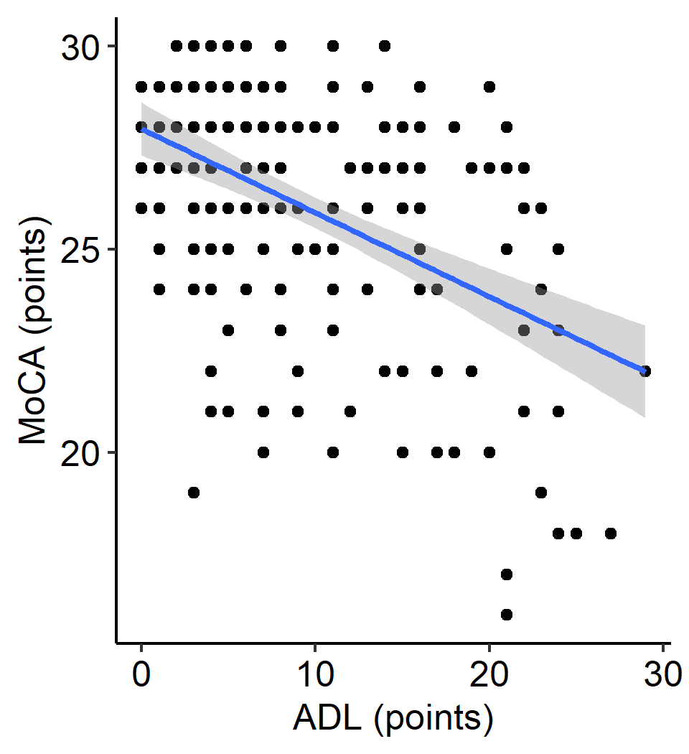
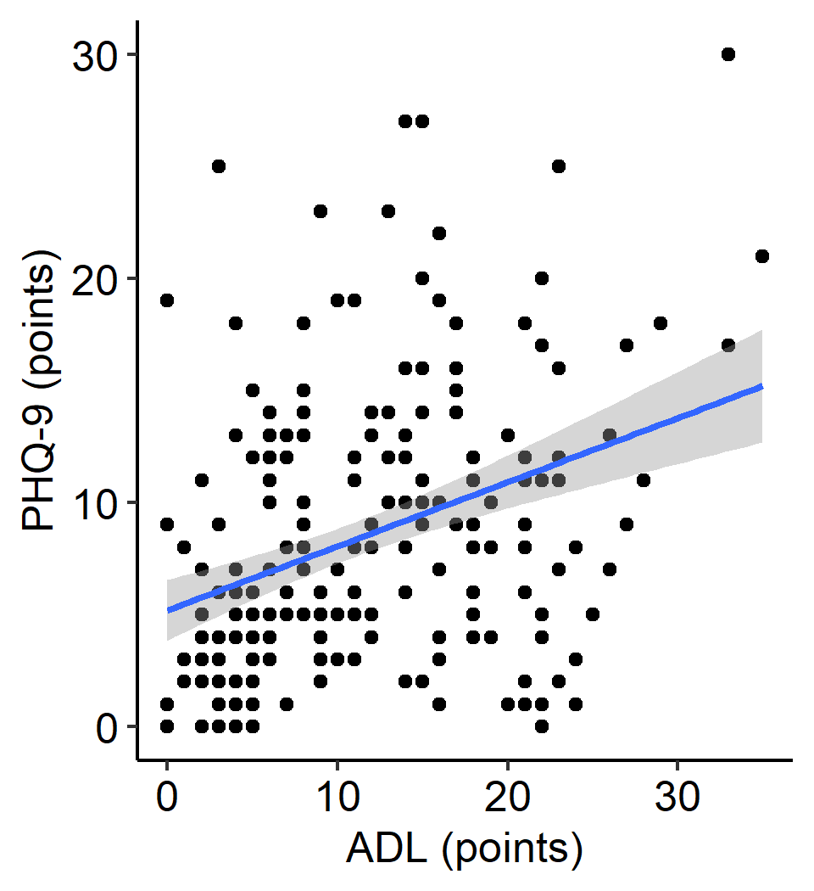
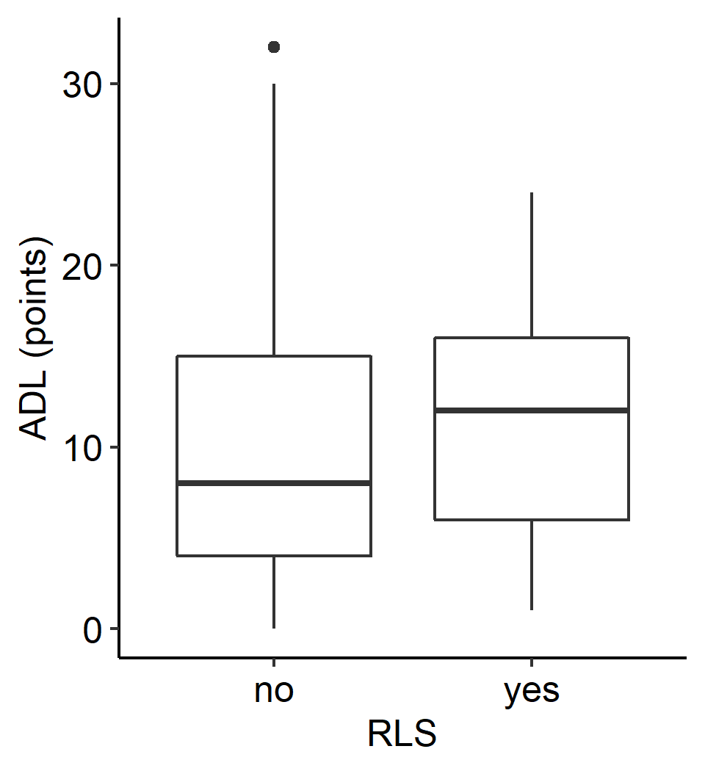
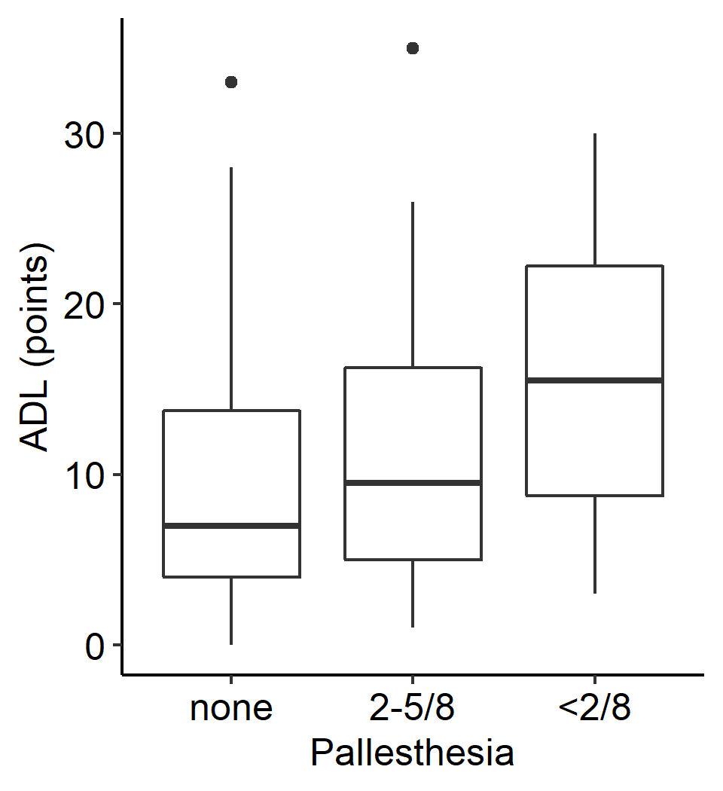
Supplementary Figure 1
A
rho = 0.35
p = 9.1x10⁻⁸
B
rho = -0.39
p = 1.5x10⁻⁸
C
rho = 0.38
p = 7.7x10⁻⁹
D
p = 0.27
E
p = 7.6x10⁻⁷
Fig S1: Exploratory correlations between NMS and ADL scores. The following NMS were investigated in relation to the ADL score: PSQI (A), MoCA (B), PHQ-9 (C), RLS (D), pallhypesthesia (E). All NMS were correlated with the ADL score.

Slide 2
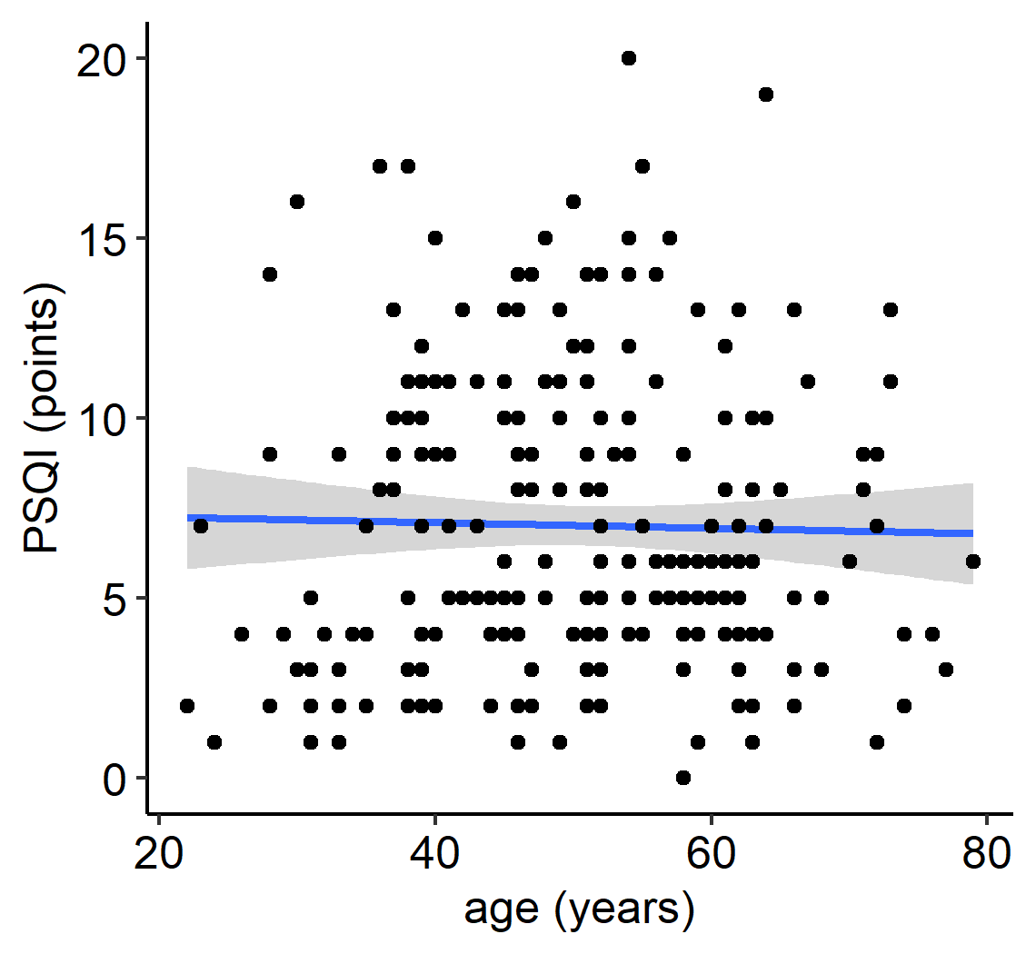
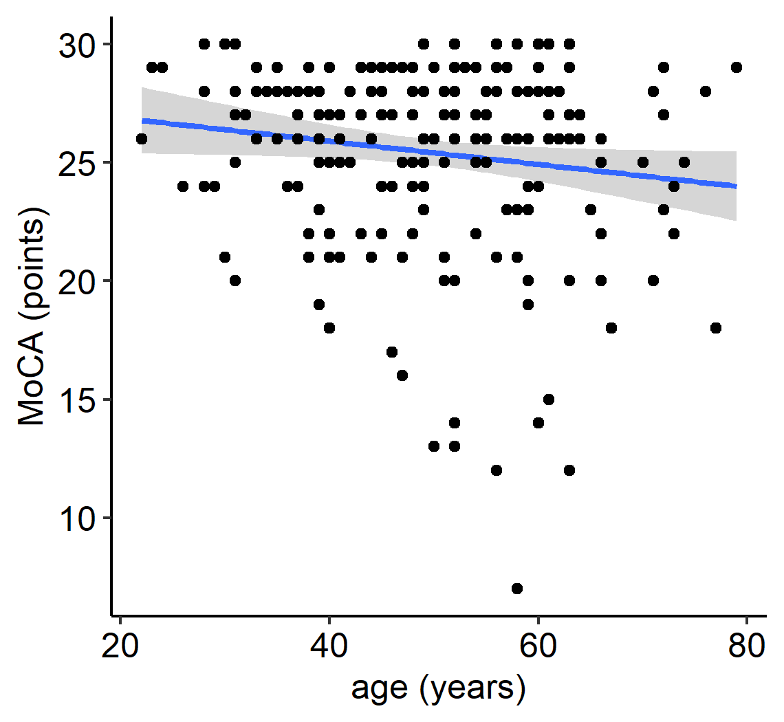
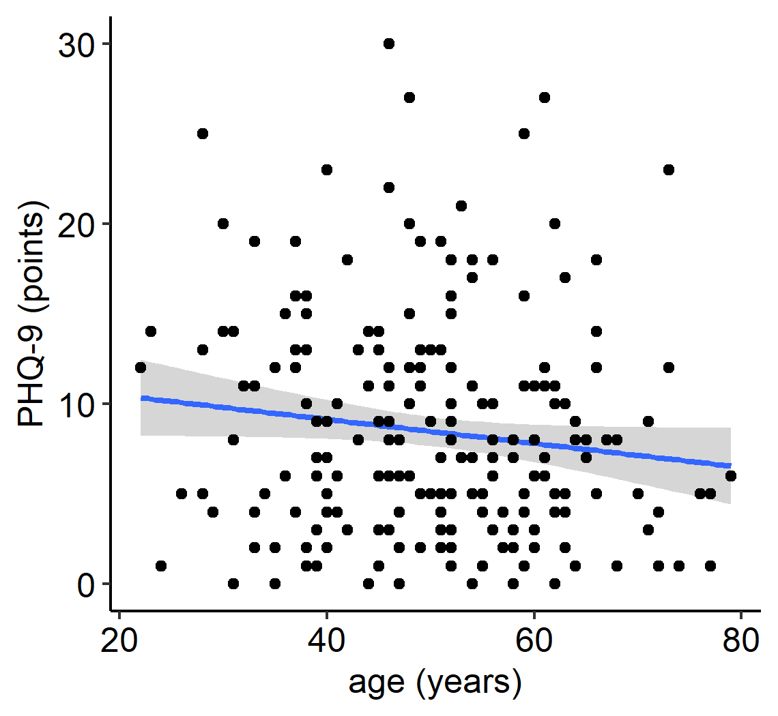
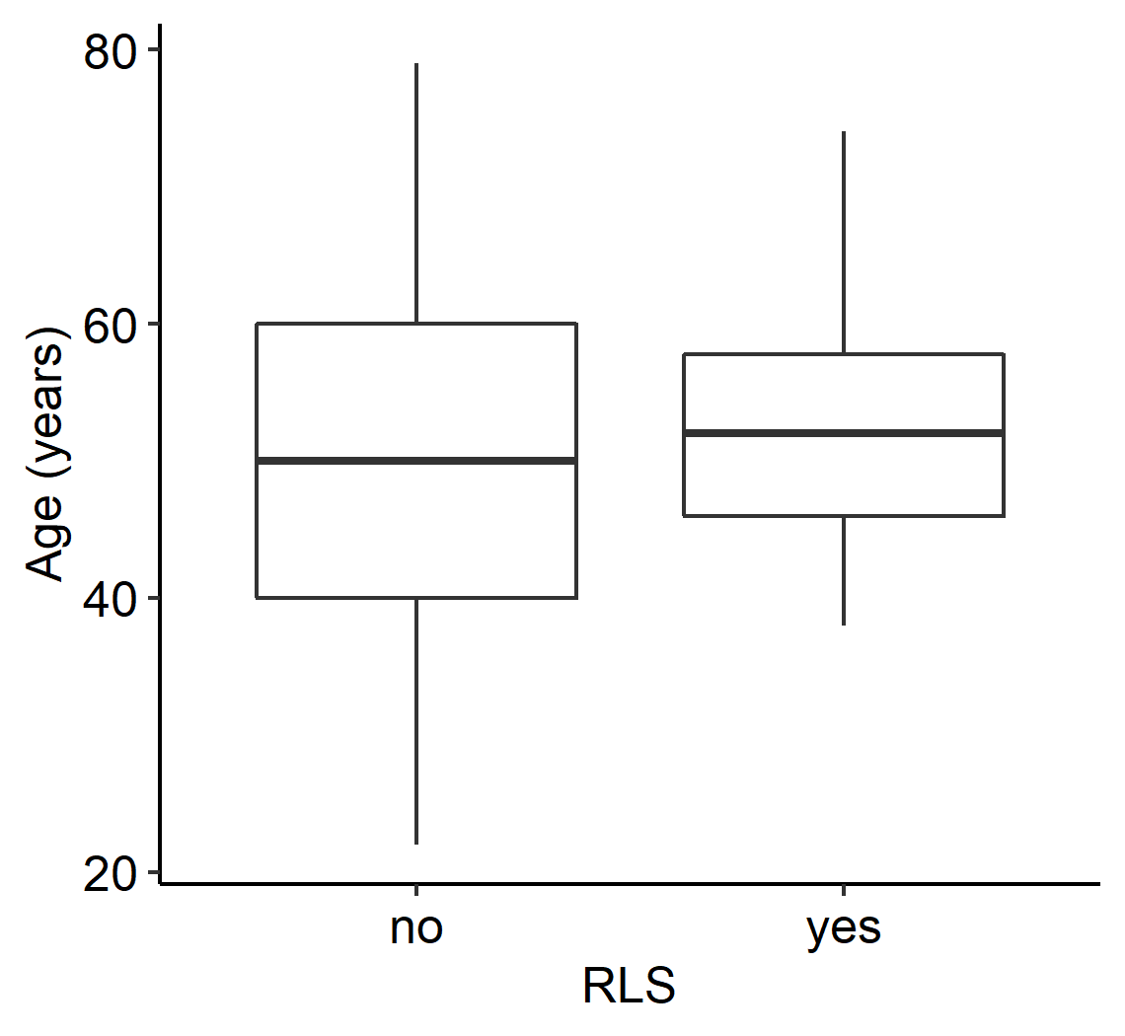
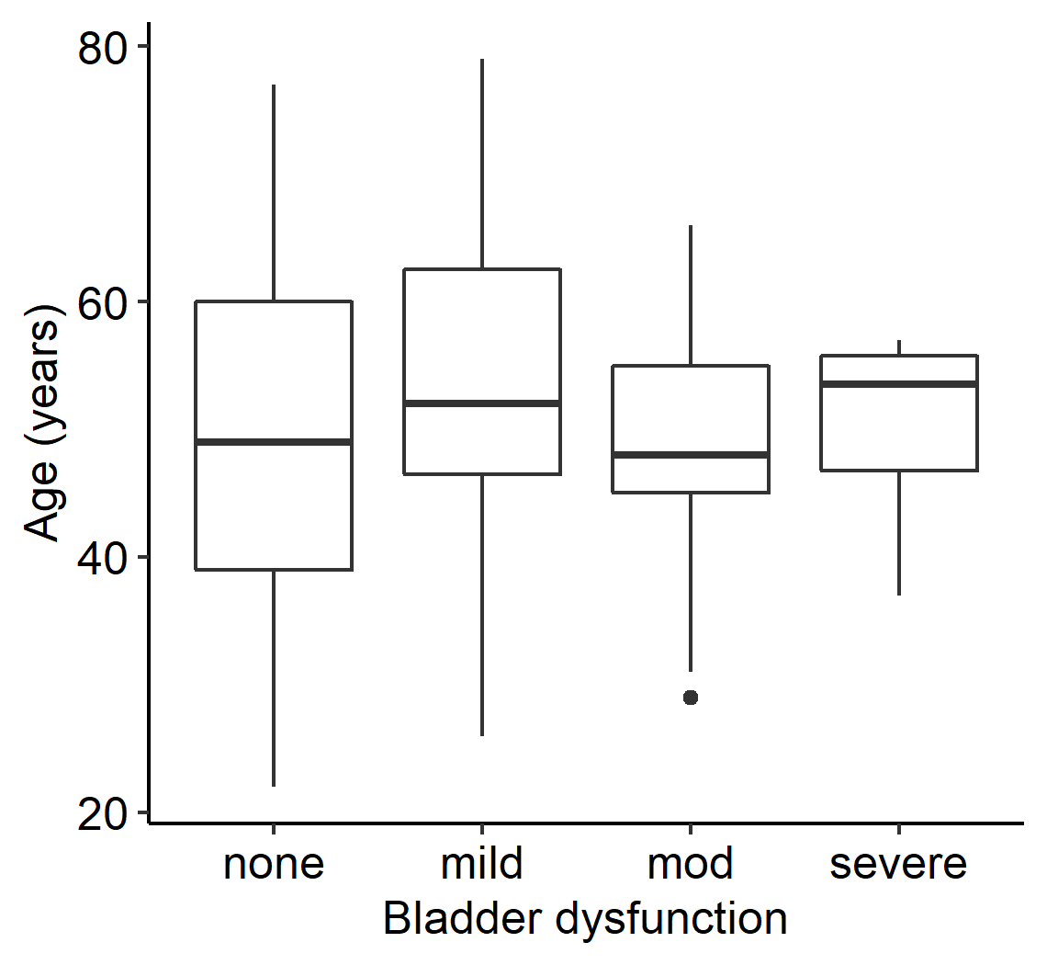
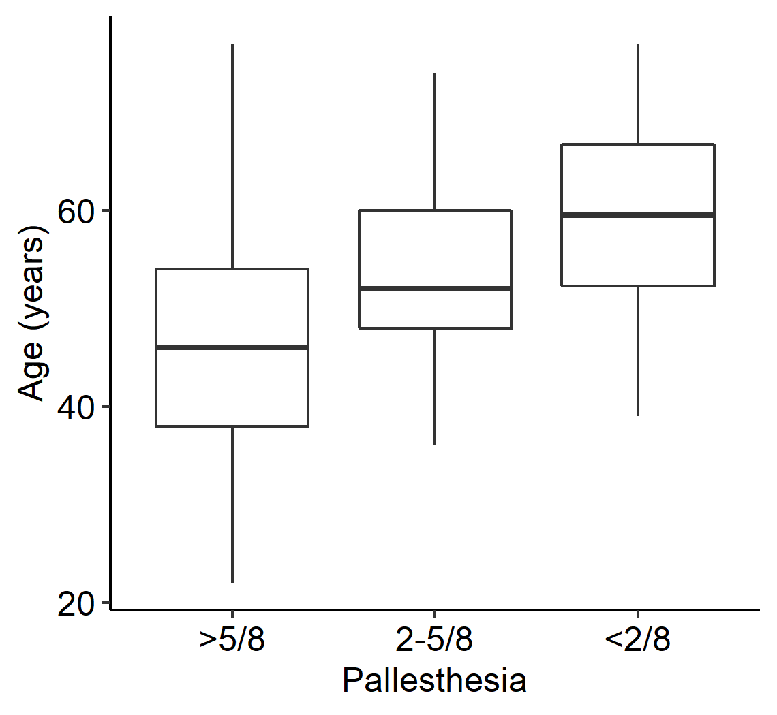
Supplementary Figure 2
A
rho:-0.01
p = 0.76
B
rho:-0.12
p = 0.090
rho:-0.13
p = 0.046
C
D
p = 0.090
E
p = 0.11
F
p = 6.6x10⁻¹¹
Fig S2: Exploratory correlations between NMS and probands age. Pallhypesthesia showed a clear association with probands age (F). Other NMS PSQI (A), MoCA (B), PHQ-9 (C), RLS (D) and bladder dysfunction (E) were not associated with probands age or only had small rho values.

Slide 3
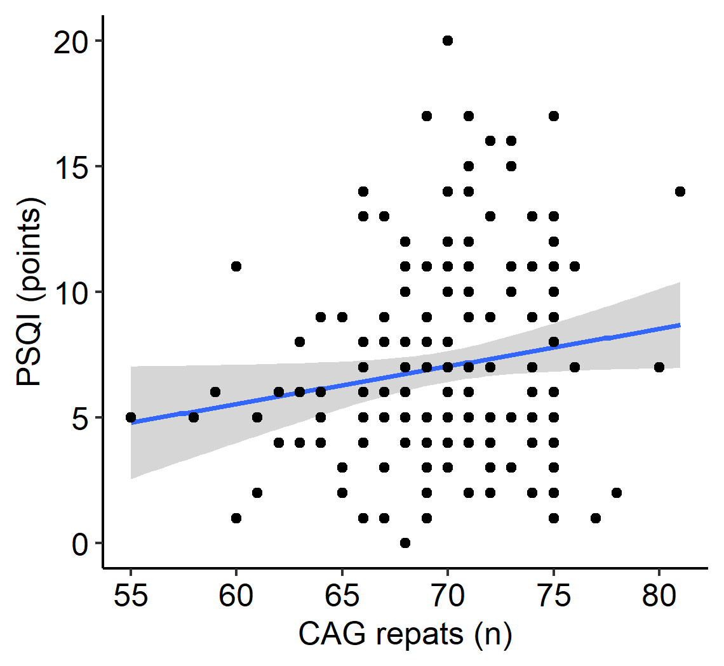
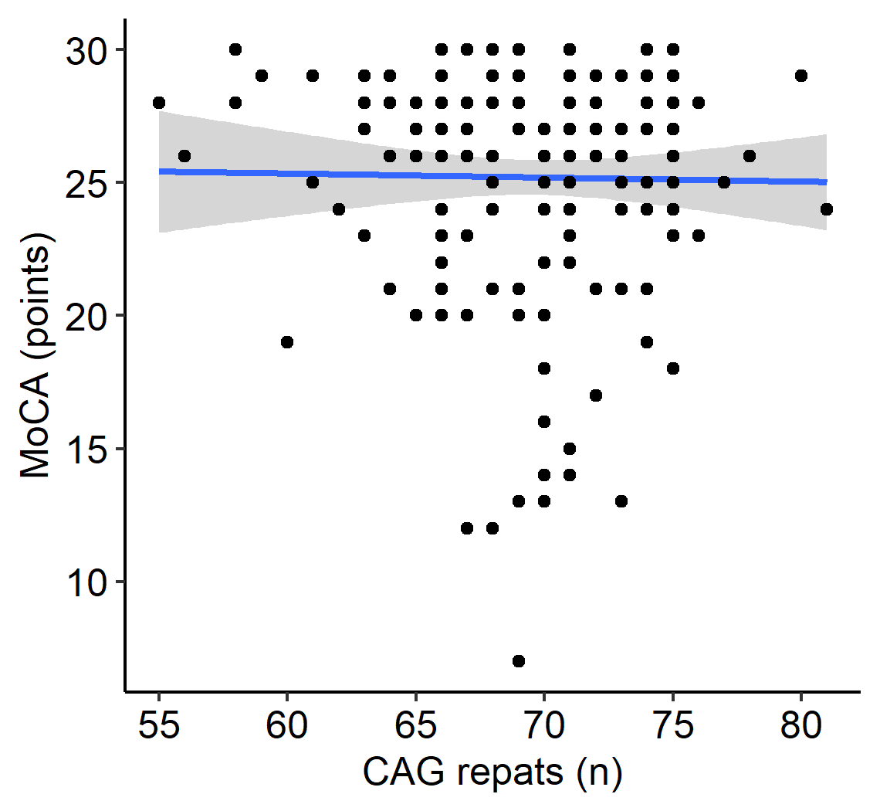
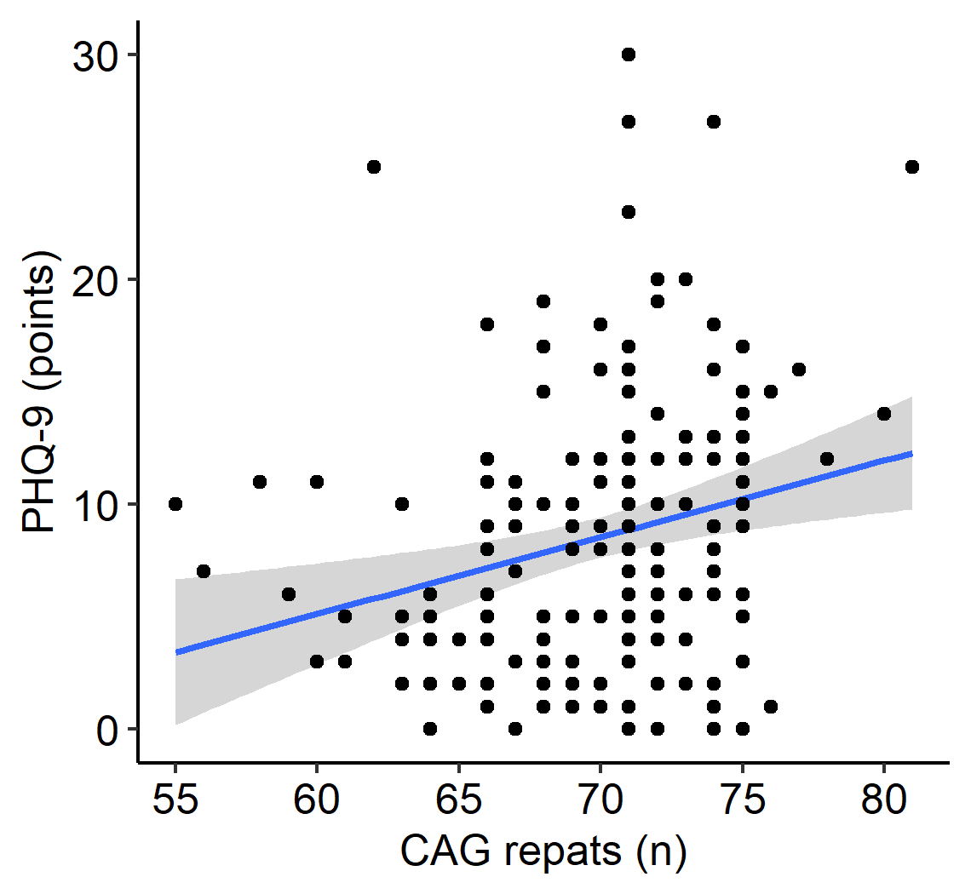
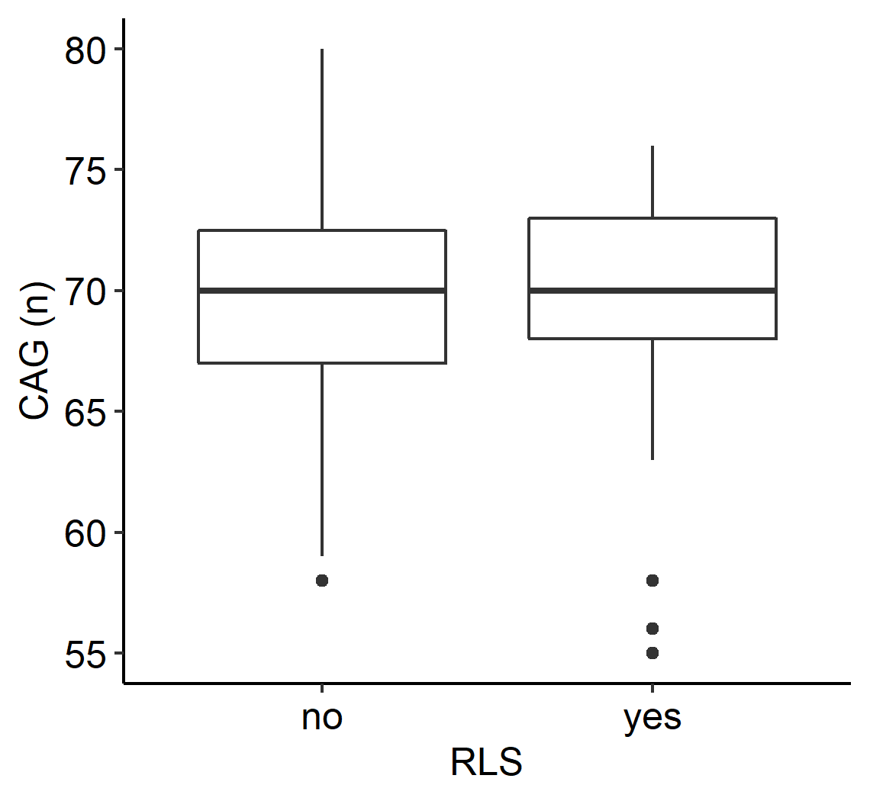
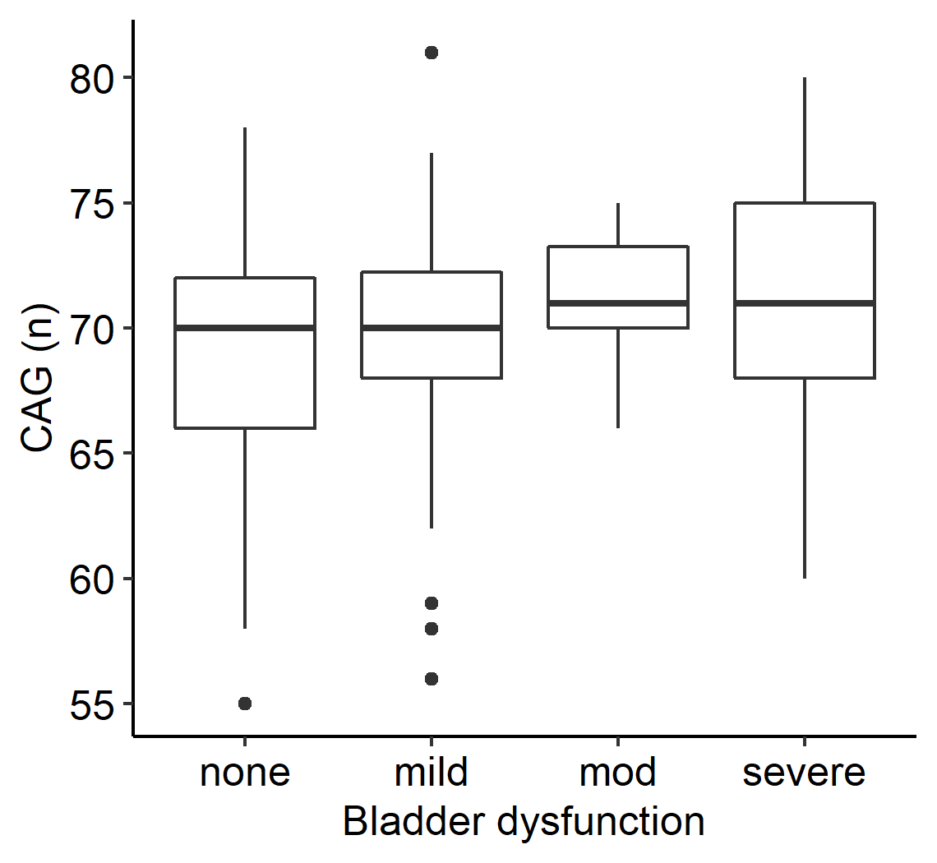
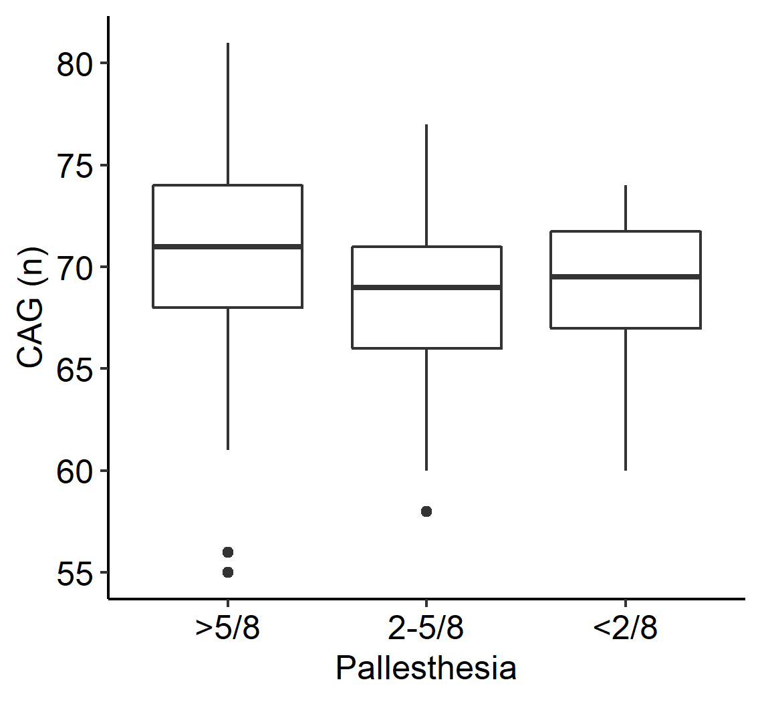
Supplementary Figure 3
A
rho = 0.11
p = 0.16
B
rho = 0.005
p = 0.94
rho = 0.28
p = 0.00031
C
D
p = 0.47
E
p = 0.36
F
p = 0.003
Fig S3: Exploratory correlations between NMS and CAG repeat length. Probands with longer repeats seemed to be more depressive (C). Pallhypesthesia was associated with a shorter repeat length (F). No association was seen for CAG repeat length and PSQI (A), MoCA (B), RLS (D) and bladder dysfunction (E).

